Slide 1
Art & the Environment Lesson 2: Changing Landscapes
www.albanyinstitute.org

Slide 2
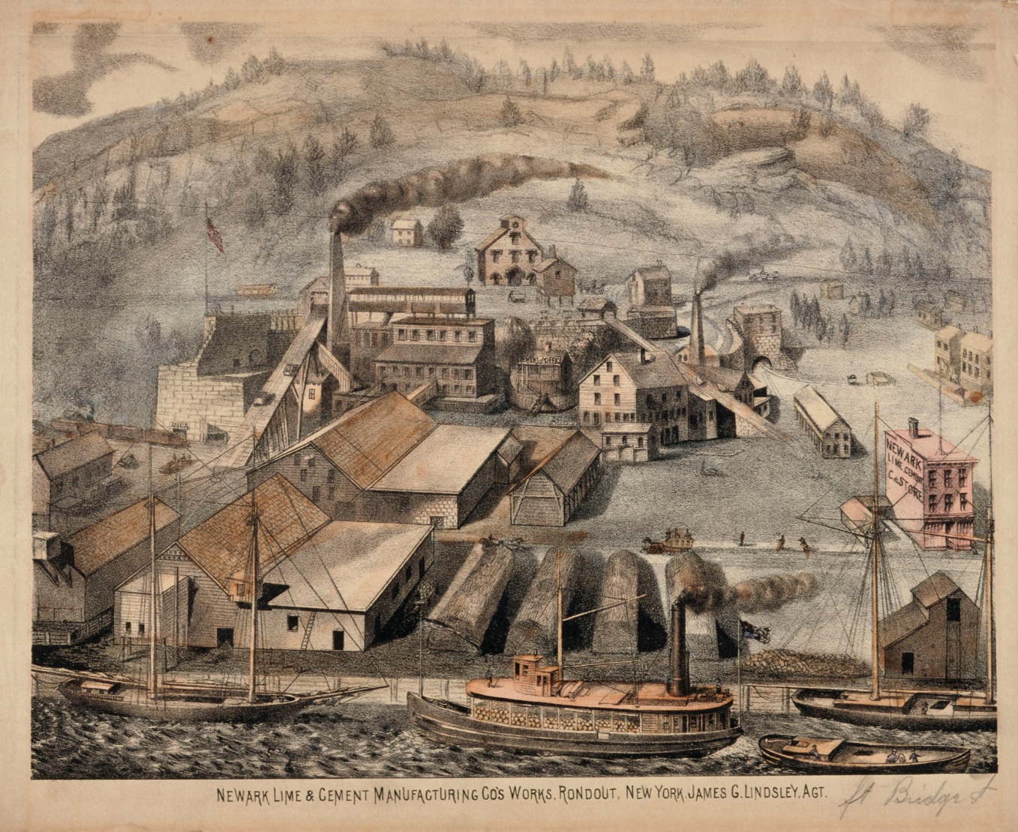
The Industrial Revolution
What was it?
Started in Great Britain during the late 1700s
Lasted over 100 years
Change from hand-crafted goods to machine produced goods
Technological advancement and new inventions
Newwark Lime & Cement Manufacturing Co.’s Works, Roundout, NY 1880
Unidentified printer
Lithograph
U1977.146

Slide 3
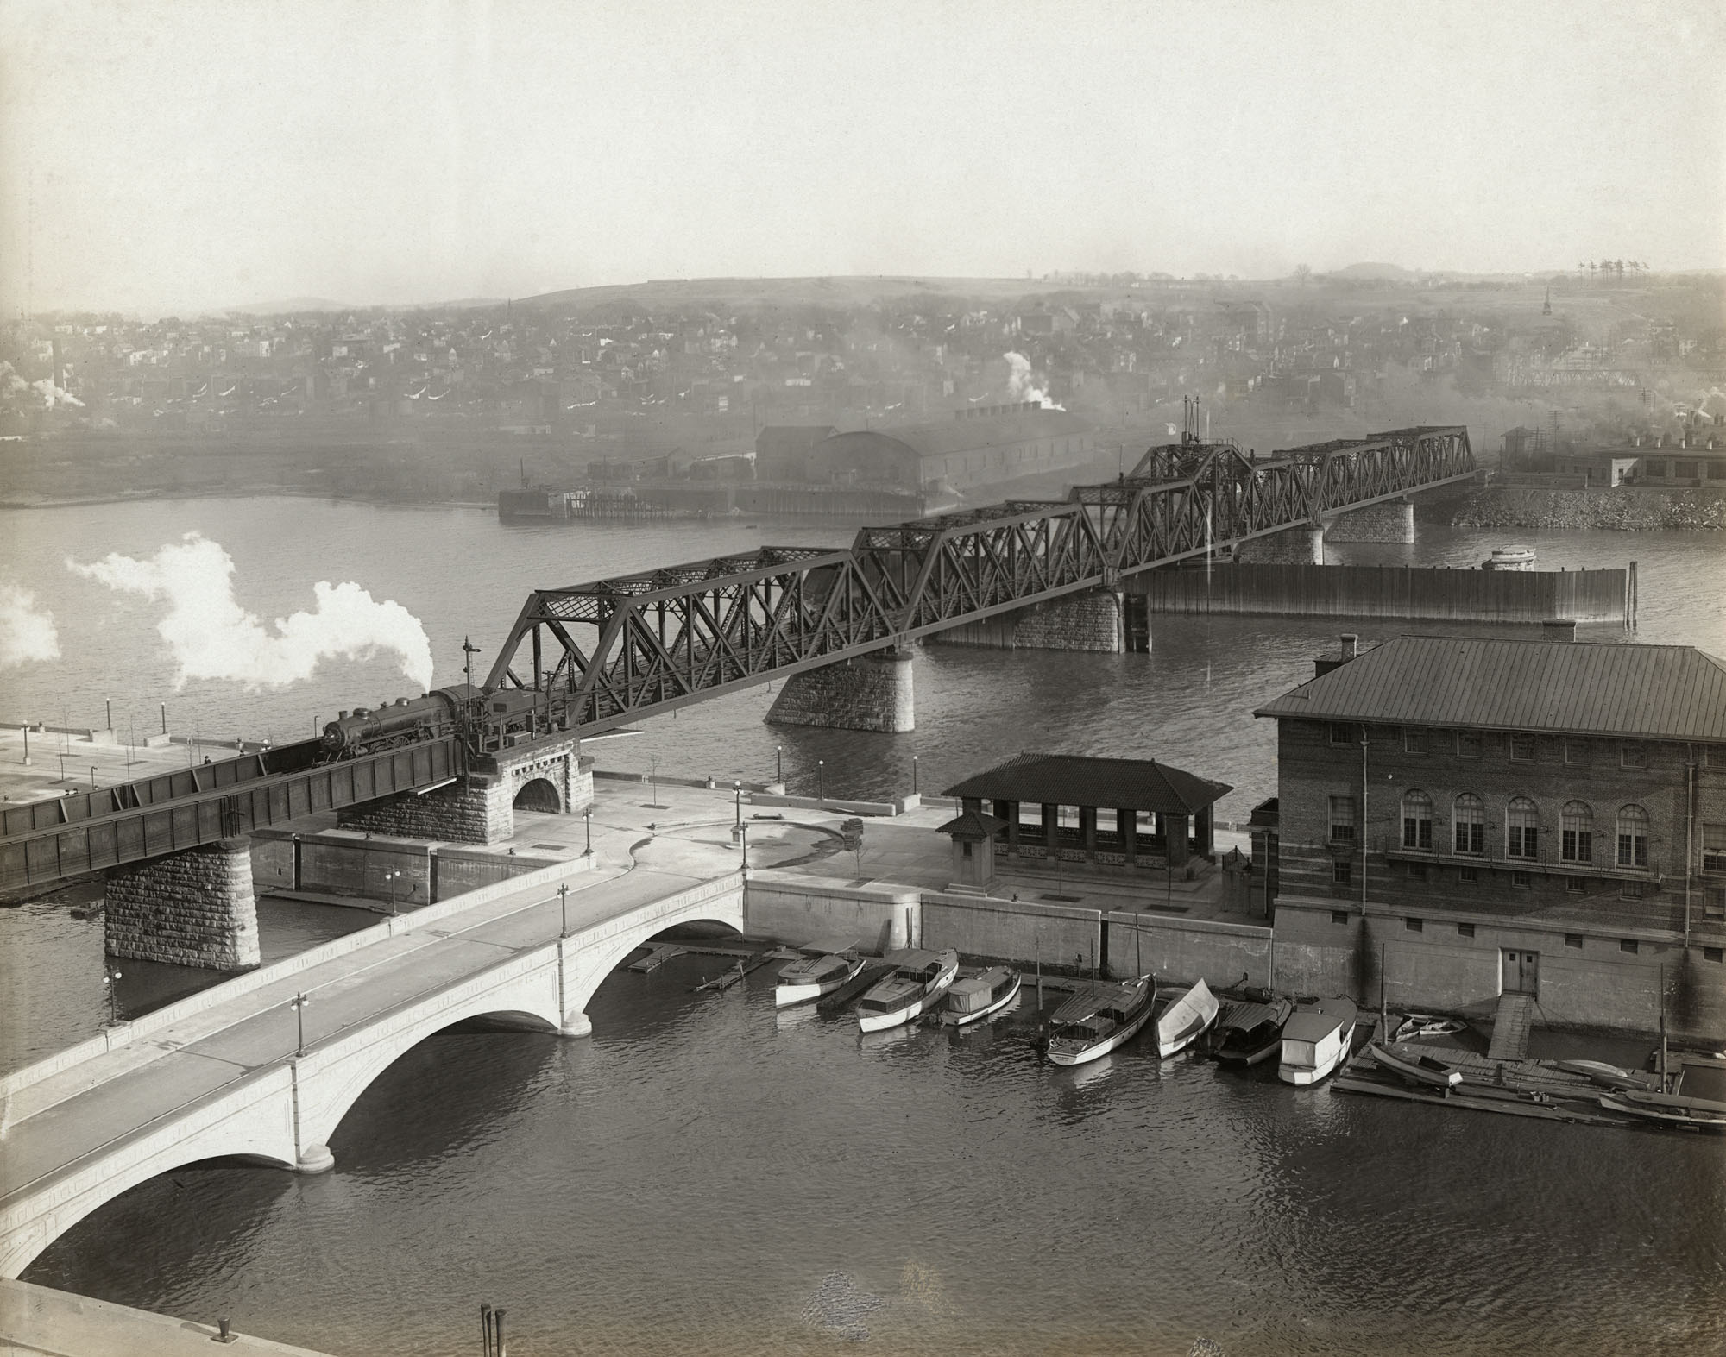
The Industrial Revolution
How did it change the United States?
Rapid urbanizations
Growth of factory work
Improvements in
transportation
Steamships
Canals
Railroads
Economic growth and technological innovation
Dependence on fossil fuels and increased pollution
Albany Yacht Club and Maiden Lane Railroad Bridge looking east, c. 1910
Unidentified Photographic Print
PC 3 138

Slide 4
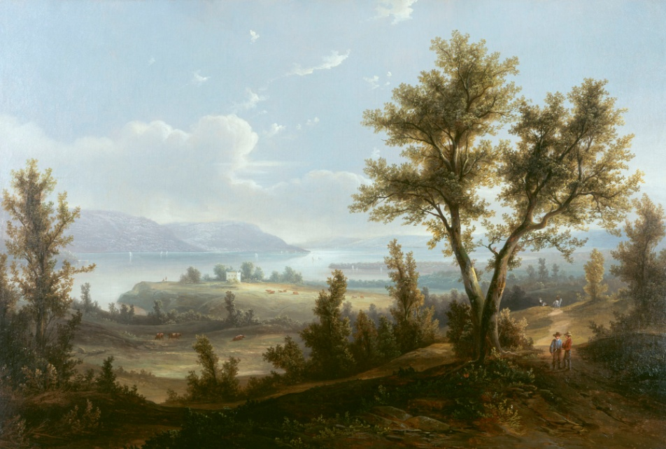
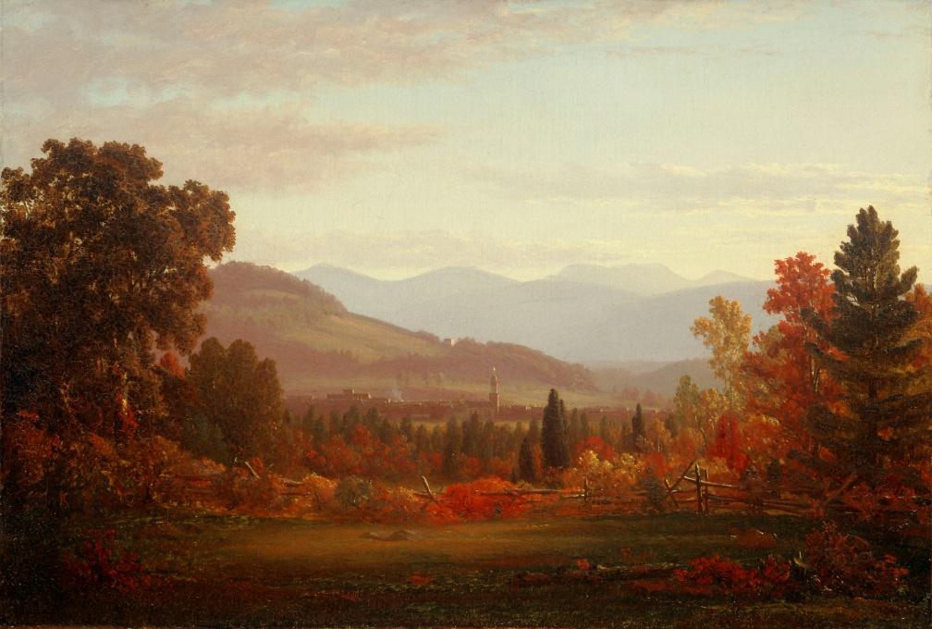
Hudson River School and the Industrial Revolution
Hudson River School artists lived during the Industrial Revolution and witnessed the changes technological advancements had on the landscape. The artists used their paintings, drawings, and writings to express their feelings about the effects of industrialization on the environment.
How do you think Hudson River School artists felt about the Industrial Revolution?
What do you think we can learn from their paintings, drawings, and writings?

Slide 5
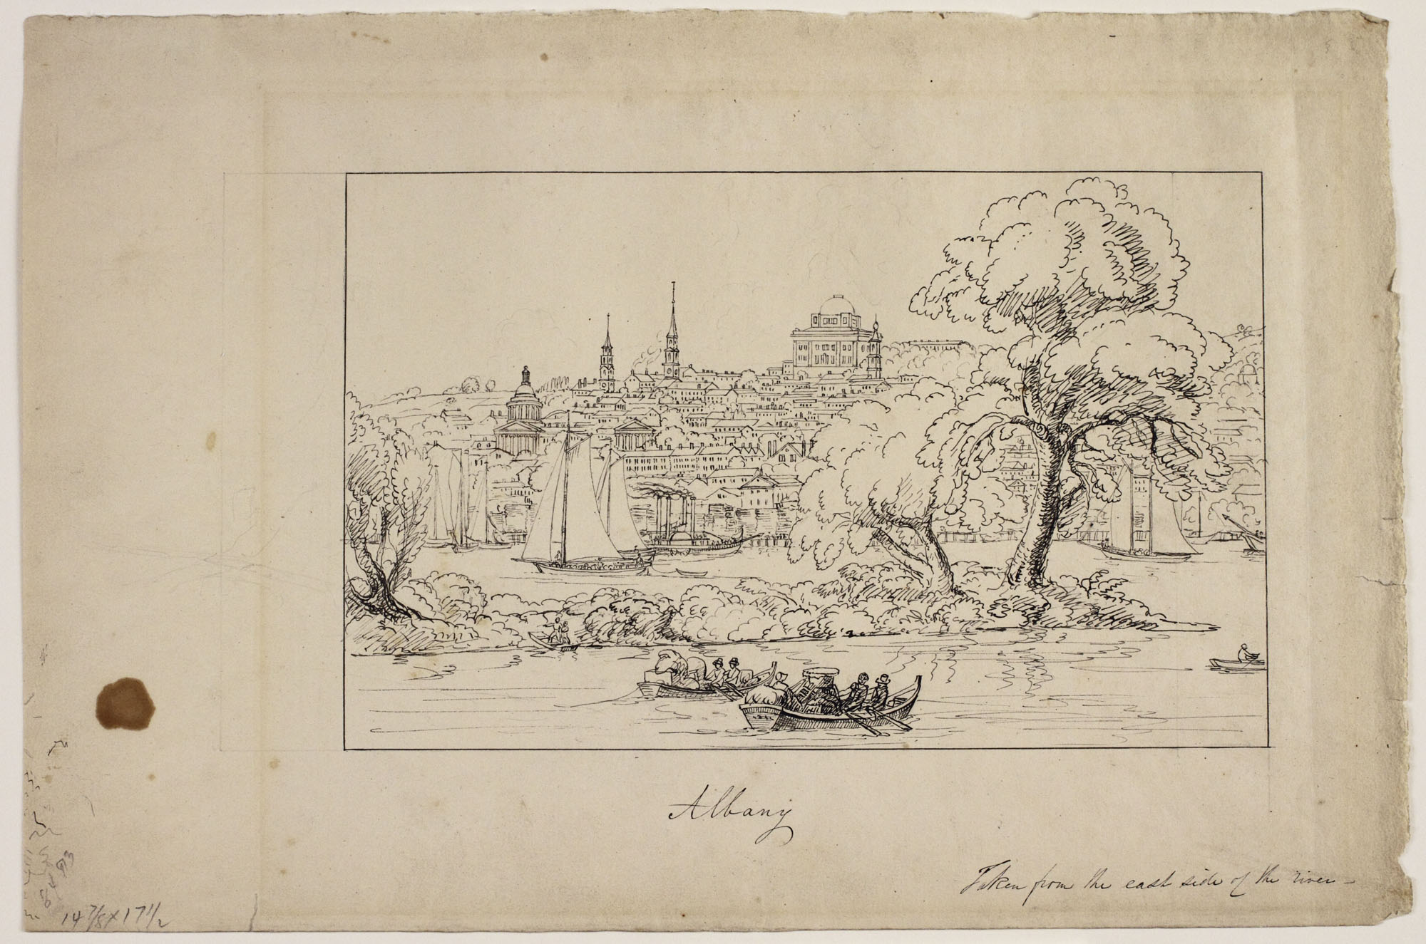
Albany, Taken from the East Side of the River; Thomas Cole (1801-1848), c. 1844, Ink on wove paper, Albany Institute of History & Art Purchase, 1940.21.1

Slide 6
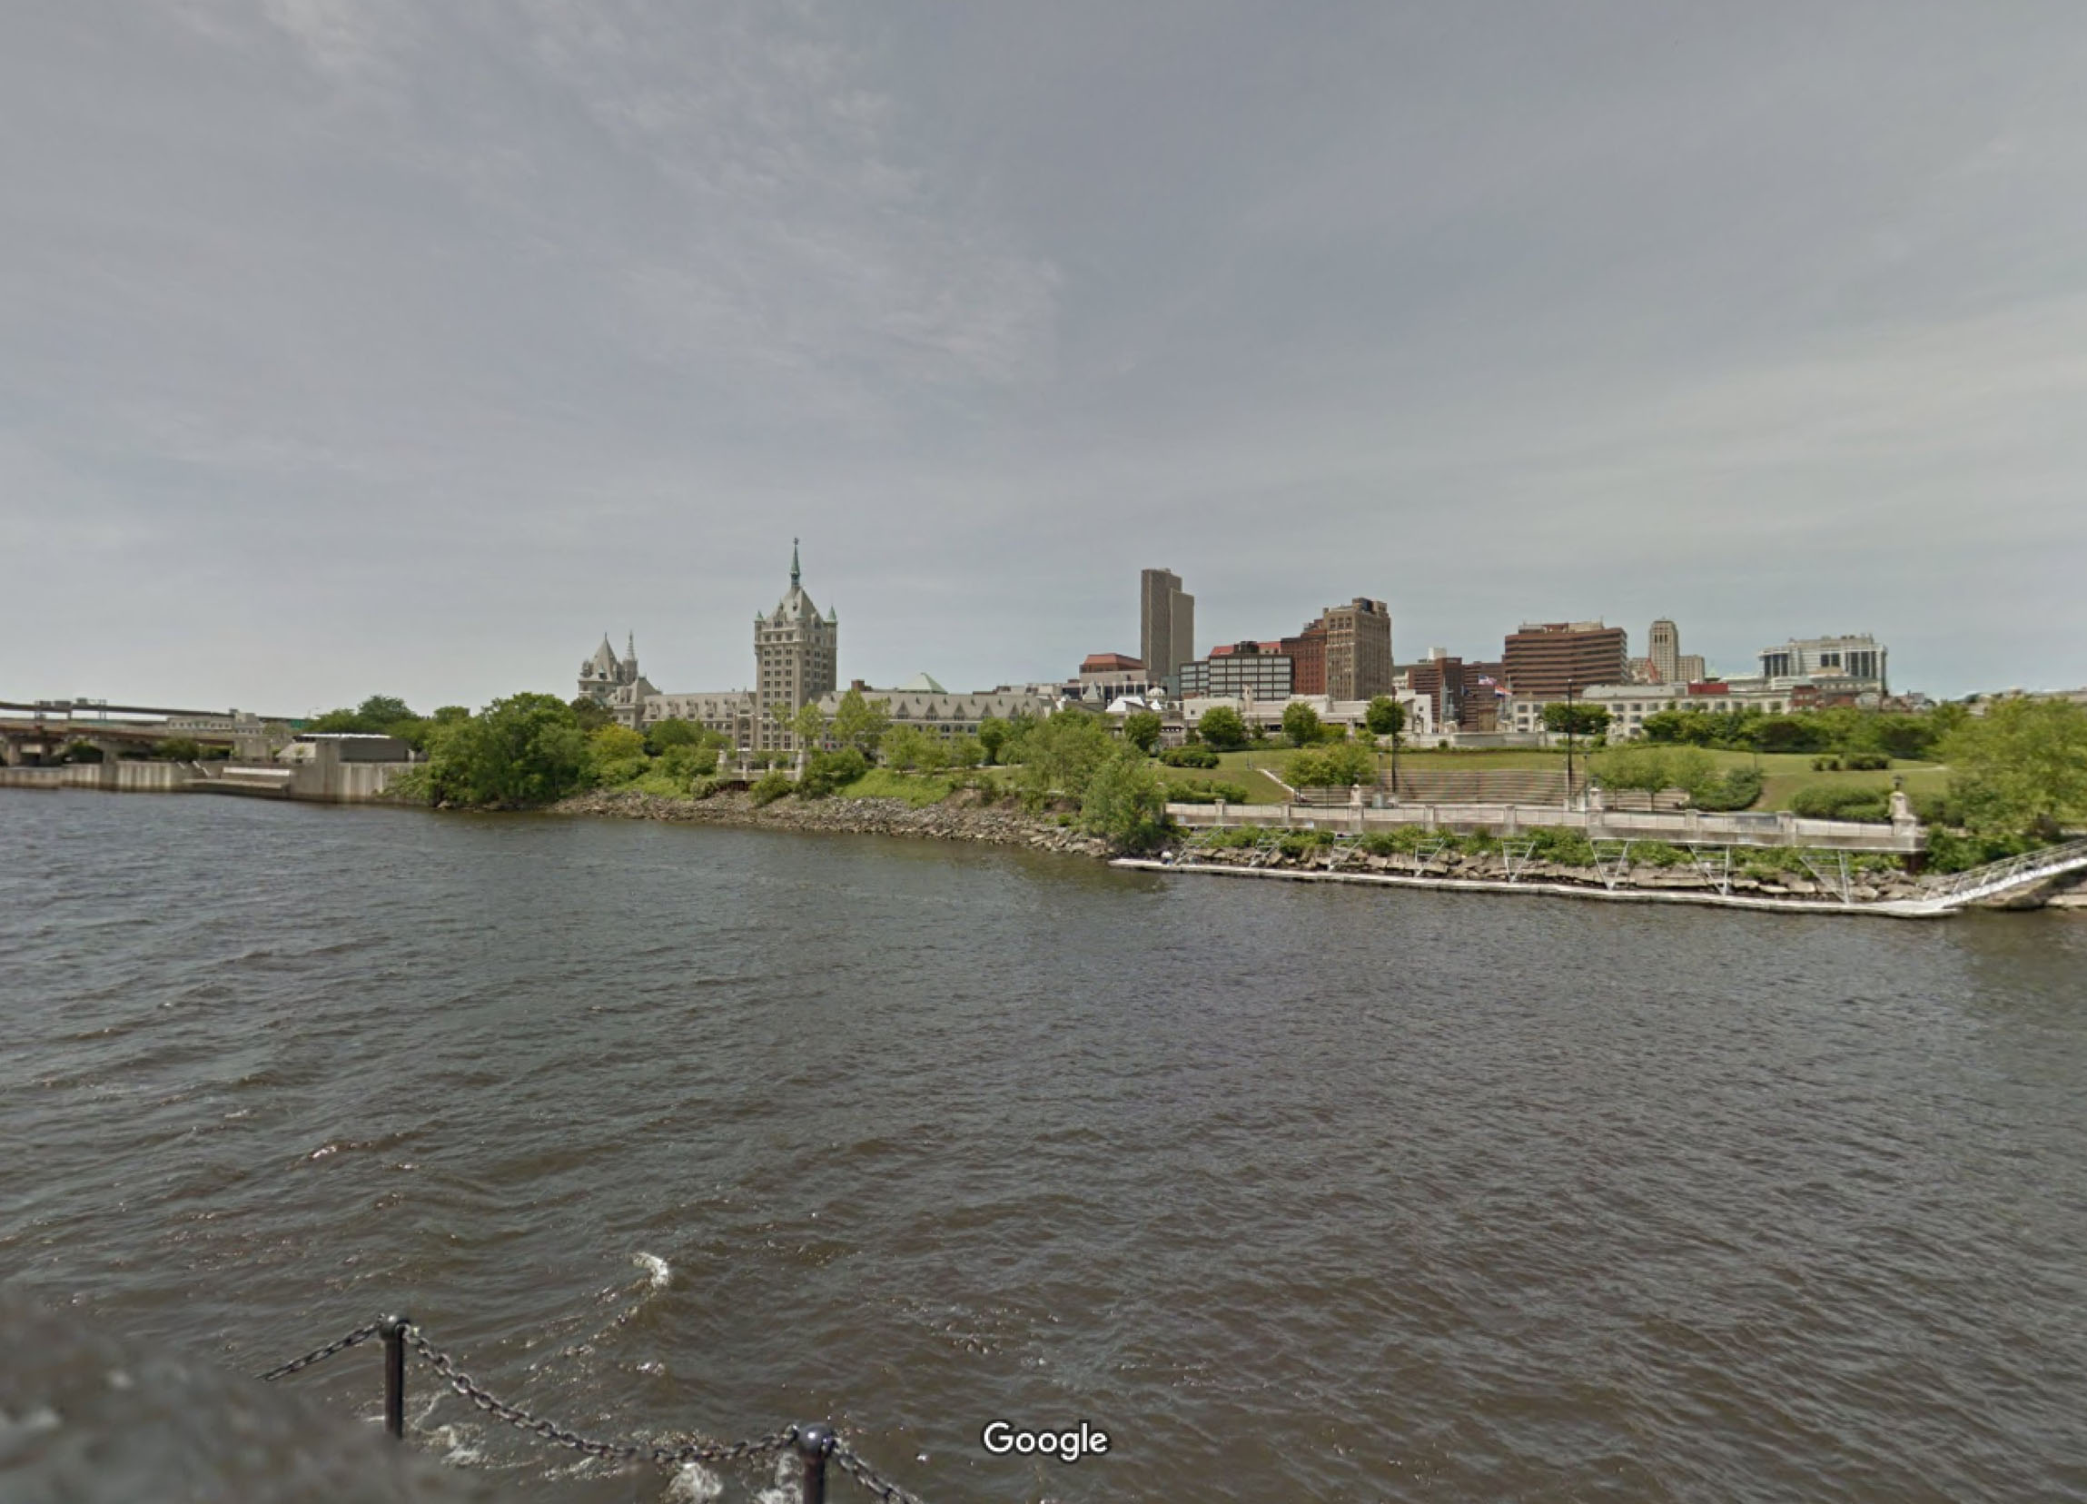
Albany, NY; Google Earth, 2015

Slide 7
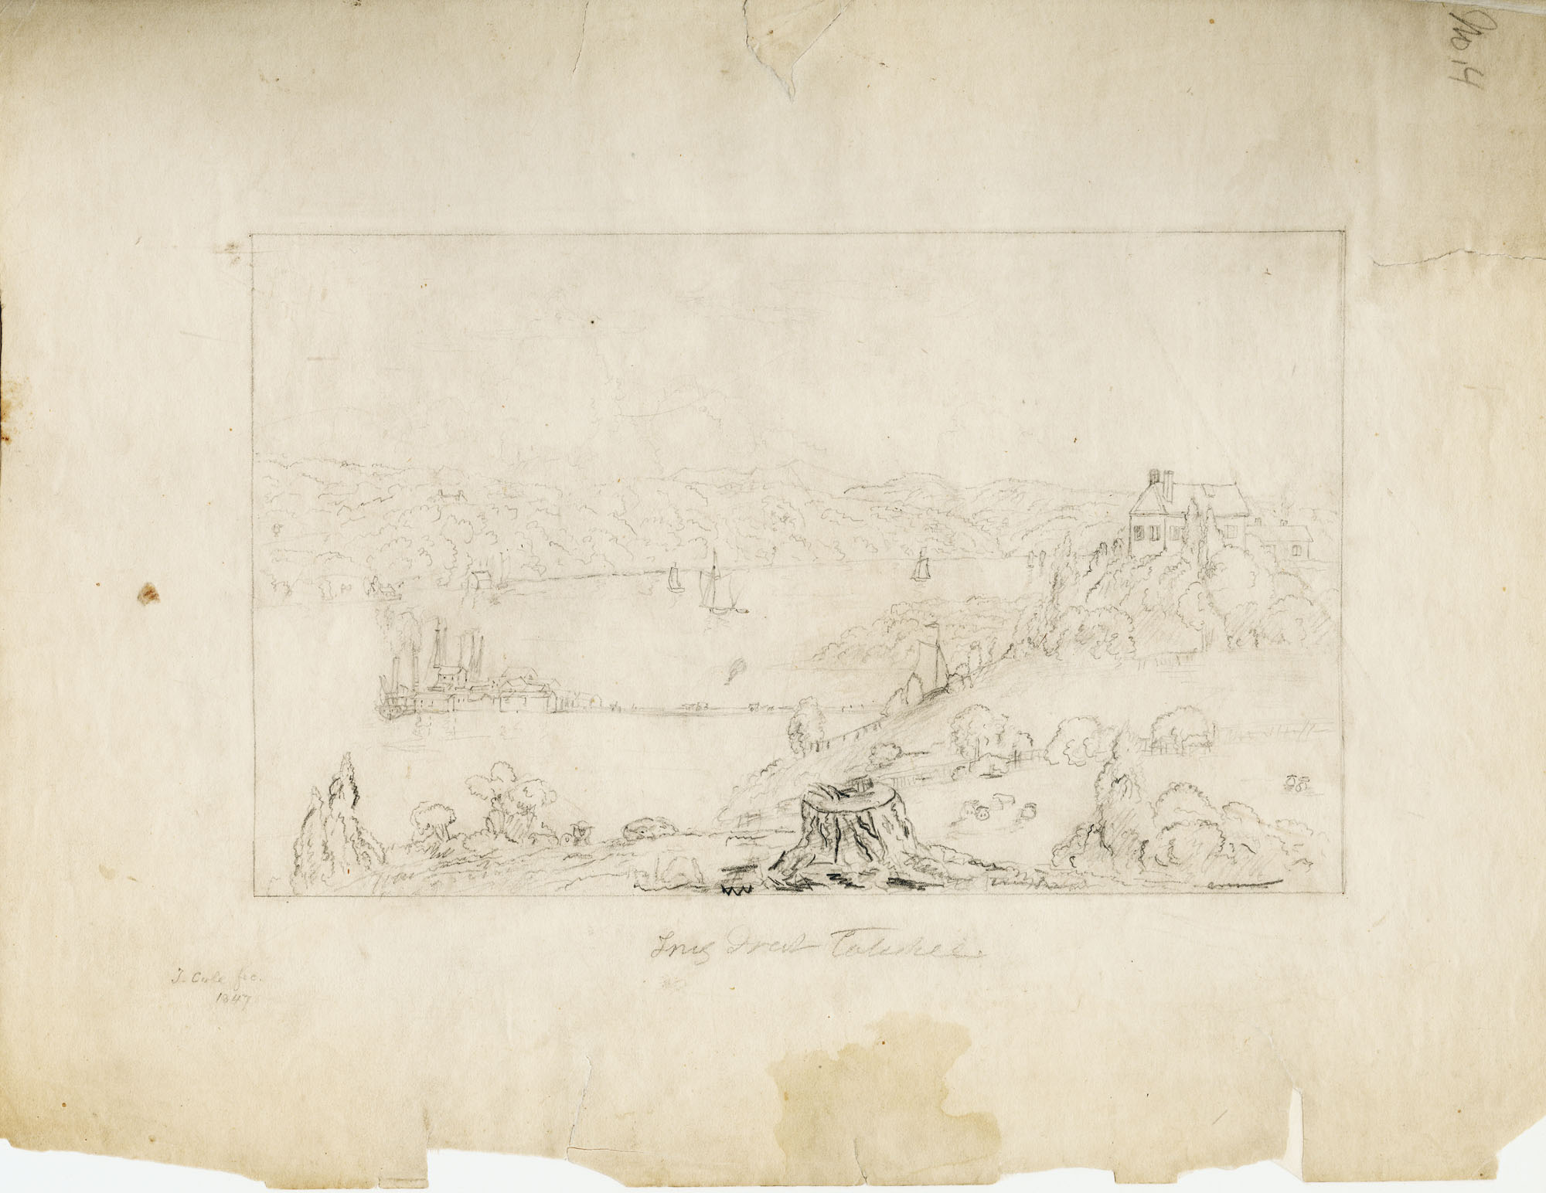
Long Dock or Catskill Landing on the Hudson River; Thomas Cole (1801-1848), 1847, Ink and pencil on paper, Albany Institute of History & Art Purchase, 1958.28.25

Slide 8
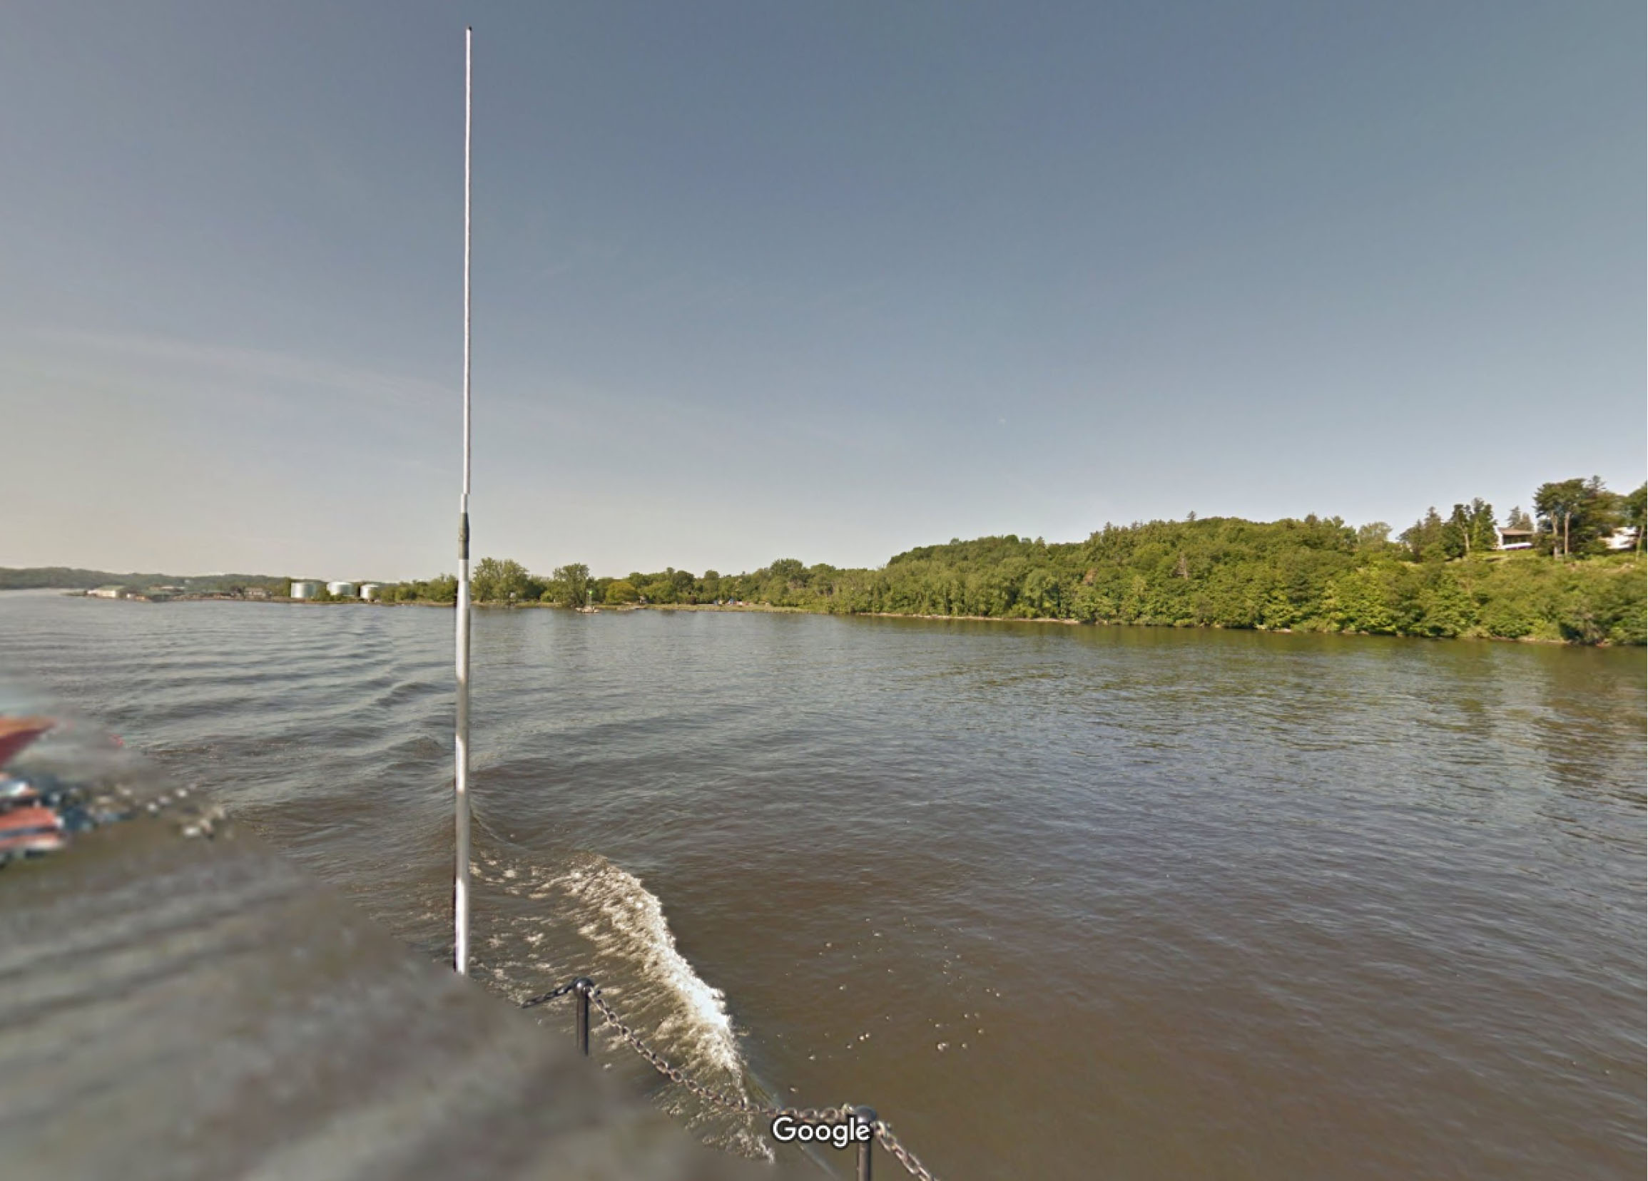
Catskill Landing; Google Earth, 2015

Slide 9
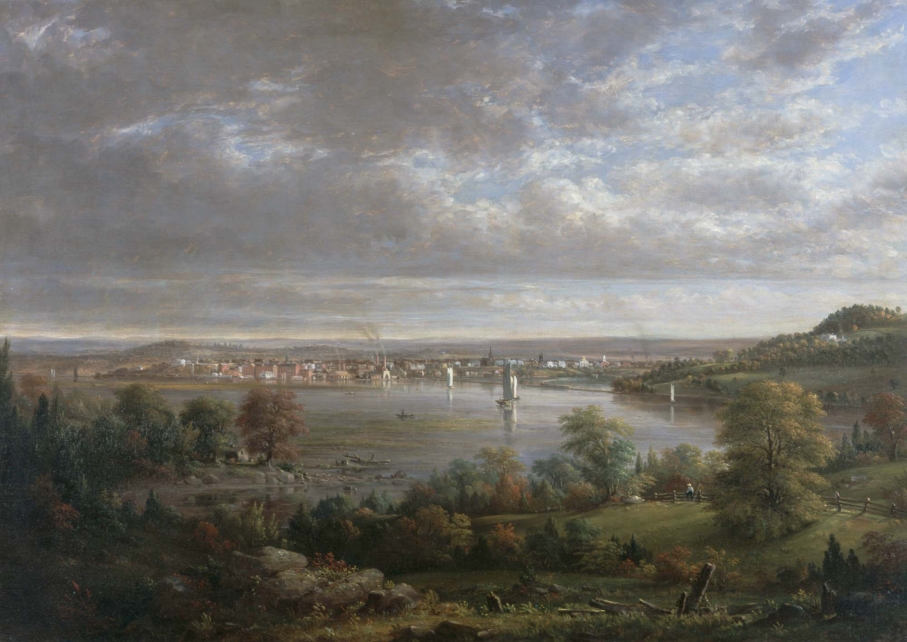
View of Hudson, New York, 1852
Henry Ary (1807-1859)
Albany Institute of History & Art Purchase, 1977.17

Slide 10
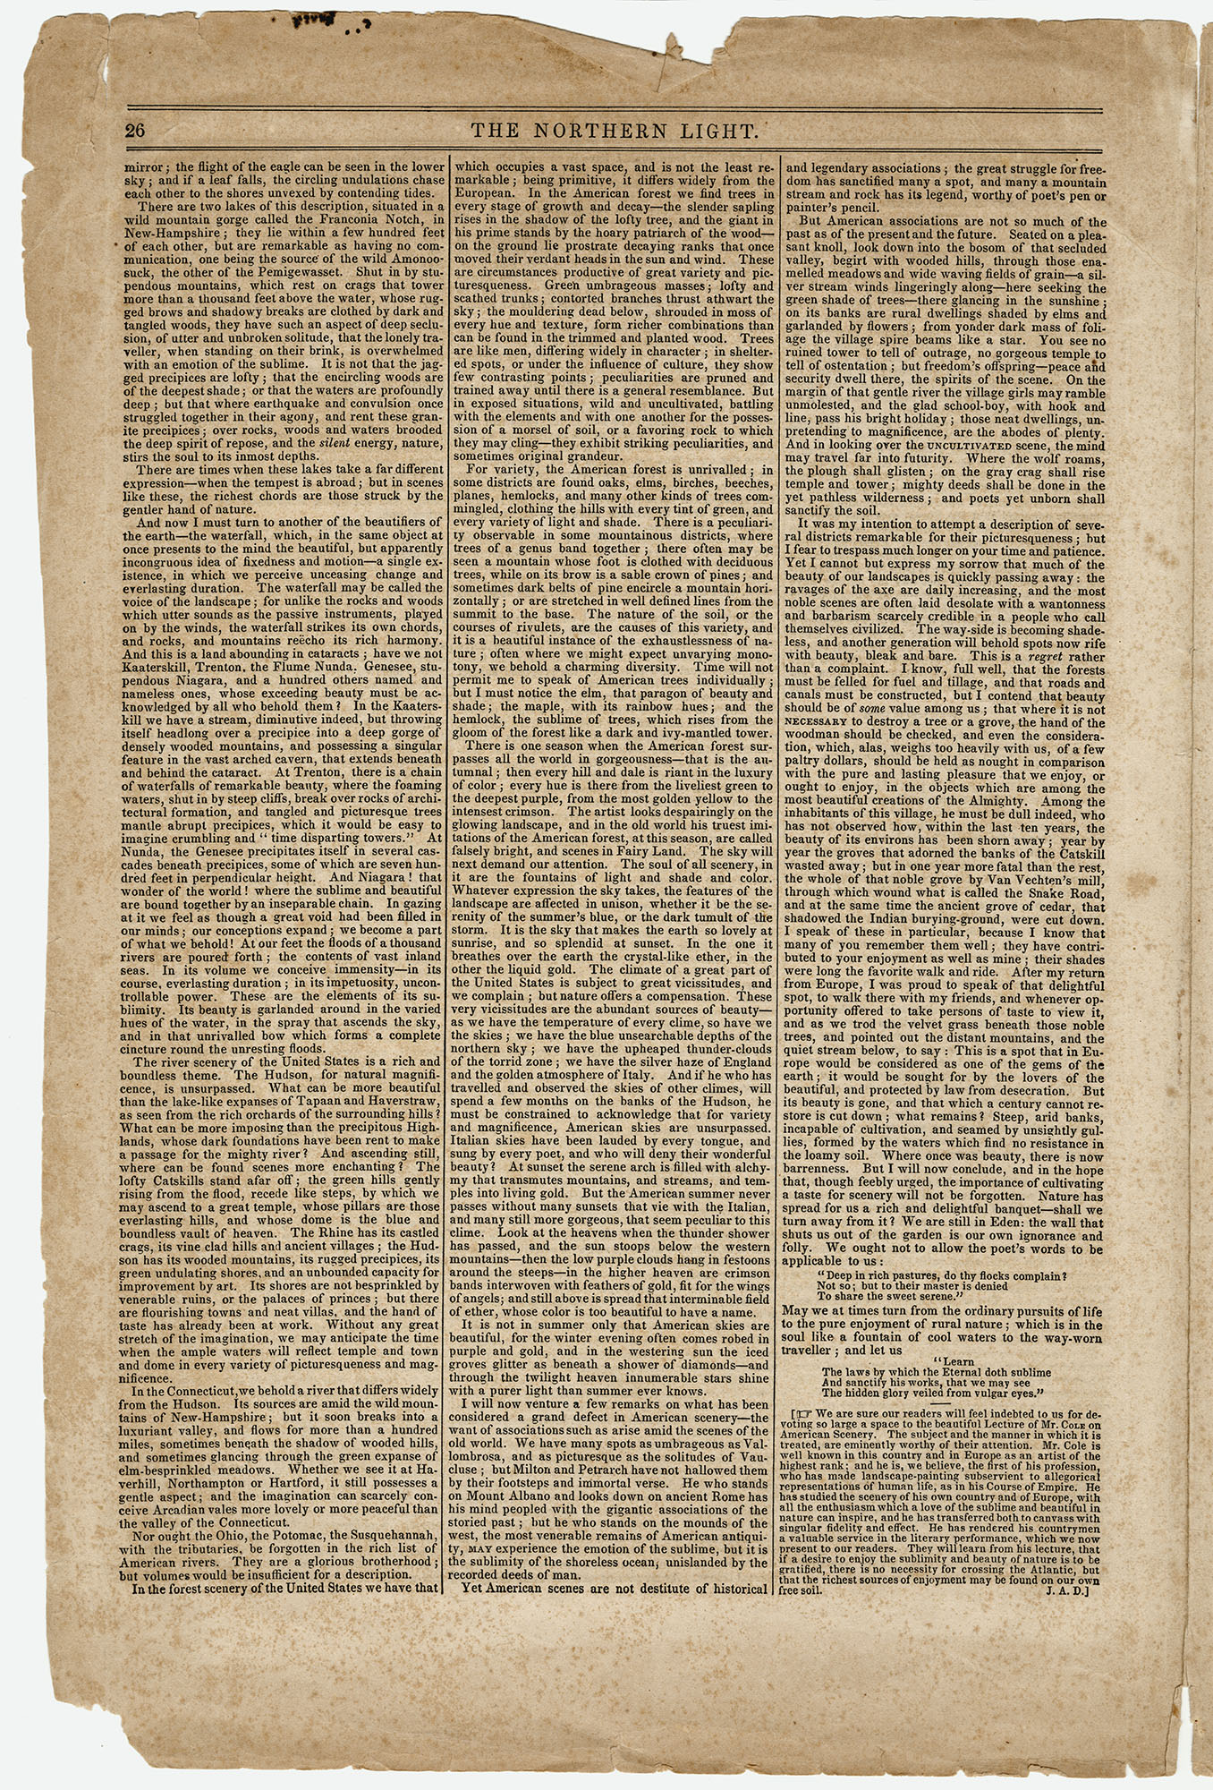
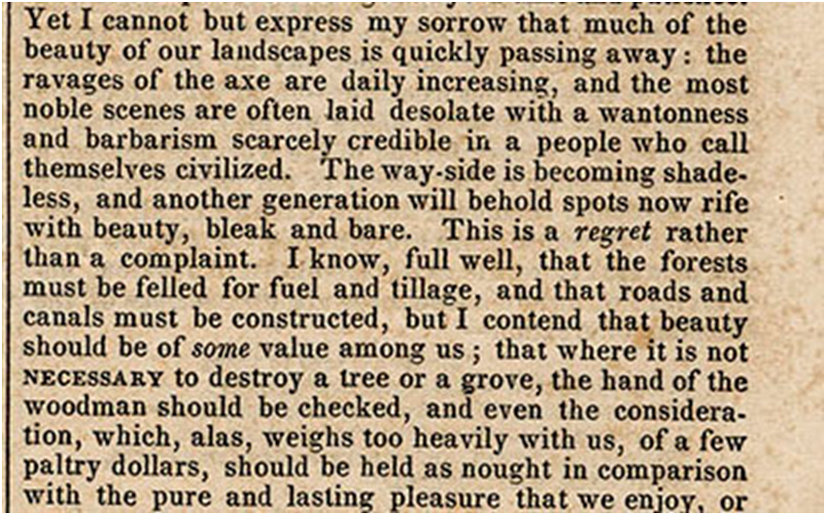
What is Thomas Cole talking about in this quote?
What concerns is he expressing?
How would you describe his tone?
Thomas Cole, excerpt from his “Lecture on American Scenery”
published in The Northern Light, 1841

Slide 11
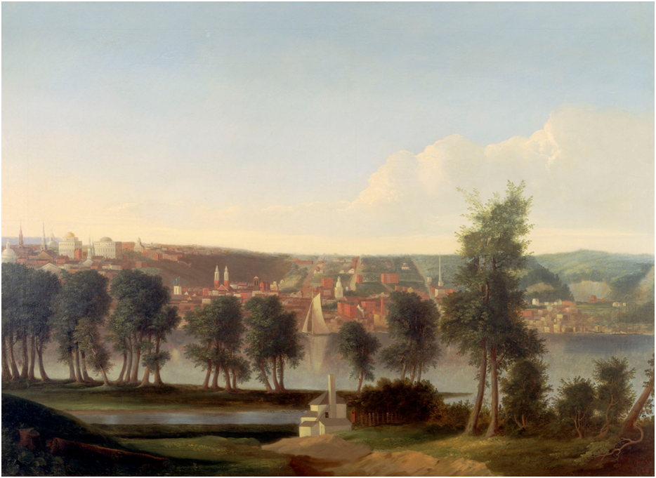
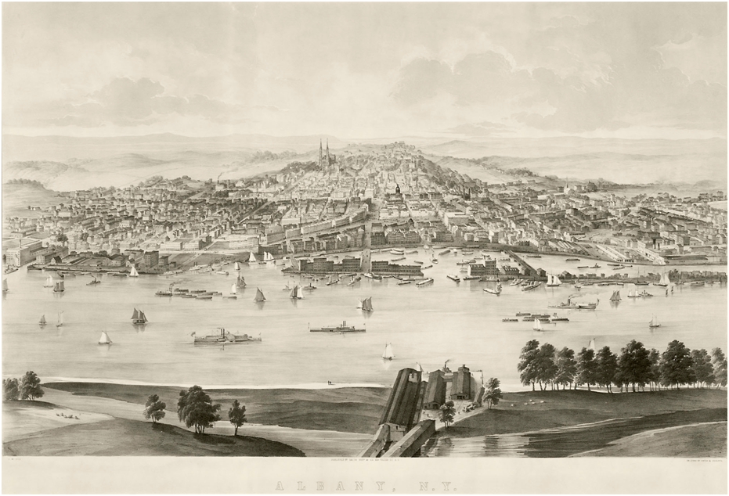
Compare and Contrast
How are these images similar?
How are they different?
Albany from the East Side of the River; William Hart (1823-1894), 1846, Oil on canvas, Albany Institute of History & Art Purchase, x1940.636.2
What do you think the purpose of the images are?
Why do you think the images portray the city of Albany the way that they do?
Albany, NY; Drawn by John William Hill (1812-1879), Lithograph, 1853, U1977.64

